Slide 1

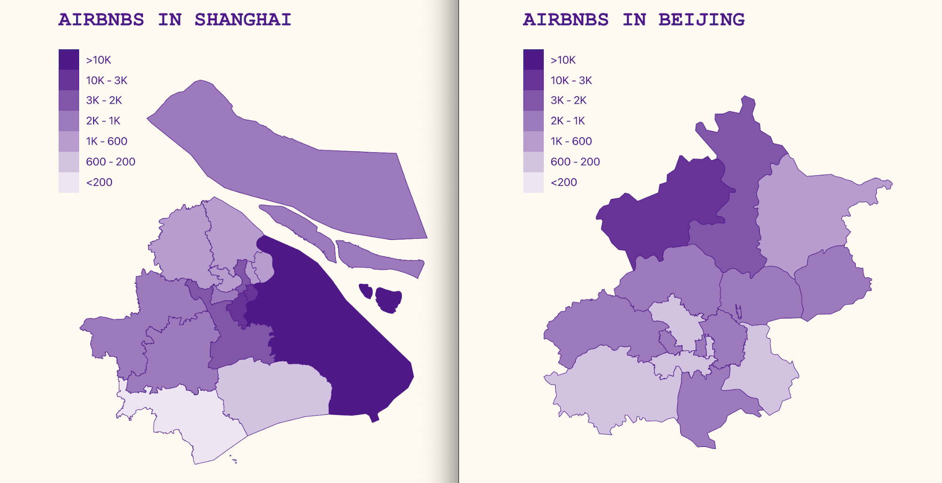
Visualizing Airbnb Neighbourhood Listings
By Andrew, Anna and Brandon

Slide 2

Task Analysis
1. Which neighbourhoods offer the highest number of available airbnb listings?
2. How do average listing prices differ from neighborhood to neighbourhood?
3. What are some informative aggregate statistics for each neighbourhood?
4. How does the popularity of neighbourhoods vary over the course of a year?

Slide 3
Datasets
Geojson:
Spatial data for mapping relevant cities and regions
Airbnb Listings:
More than 30,000 listings for the relevant regions (Shanghai and Beijing)
Listing data for relevant cities, filtered to fulfill tasks
Airbnb Reviews:
Provided apartment Id and review date.

Slide 4
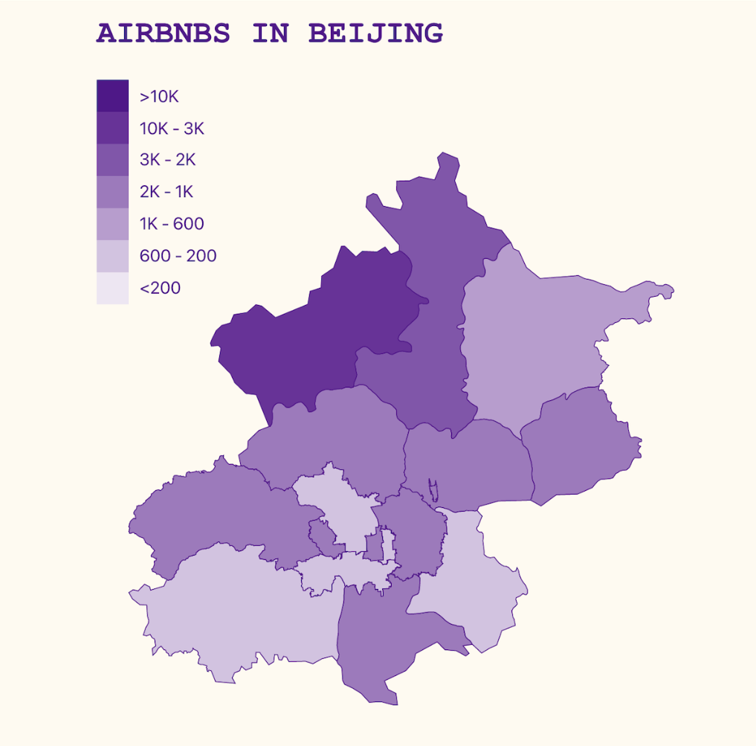
Listings per Neighbourhood
Choropleth Map
A straightforward and easy to understand visualisation for spatial data.
We decided to use the channel of color saturation to encode the numerical attribute of the number of listings as it works well for perceptual ordering.

Slide 5
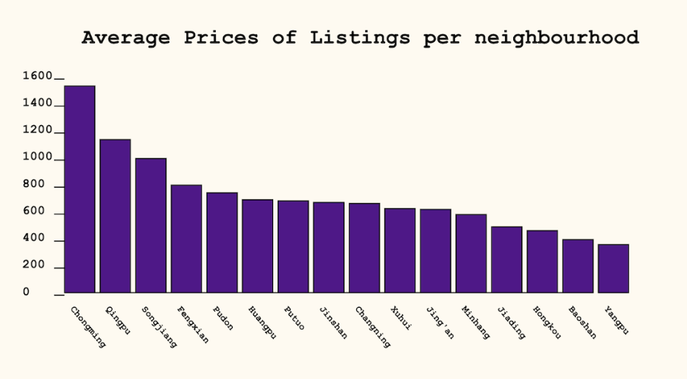
Listing Prices per Neighbourhood
Bar Graph
sorted by price, to allow for a data driven ordering that makes dataset trends more obvious and allows for easier lookup by price for the user.
The line marks are aligned within a common frame so that the highest-accuracy aligned position channel is used.
Average price (quantitative)
Neighborhood (categorical)
Notes:
sorted by price, to allow for a data driven ordering that makes dataset trends more obvious and allows for easier lookup by price for the user.
The line marks are aligned within a common frame so that the highest-accuracy aligned position channel is used.
Average price (quantitative)
Neighborhood (categorical)

Slide 6
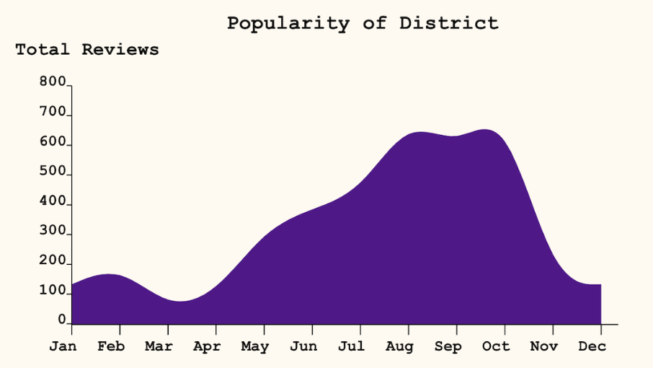
Popularity per Neighbourhood
Time Series
A cyclical structure for our visualization.
The area chart shows the popularity of each district during the year for better planning.
Total Reviews (Quantitative)
Months (Categorical)

Slide 7
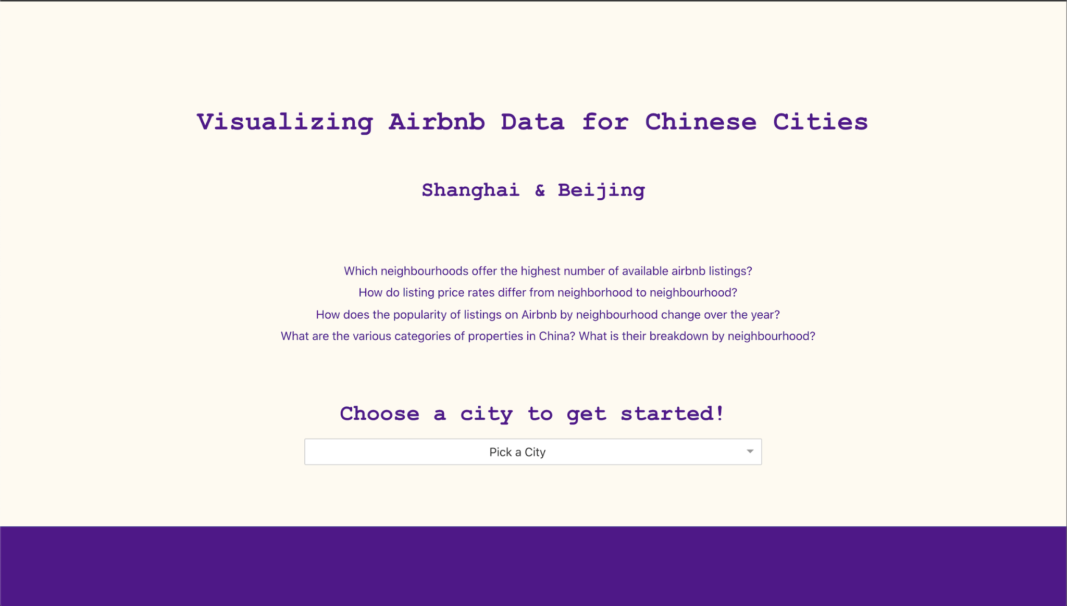
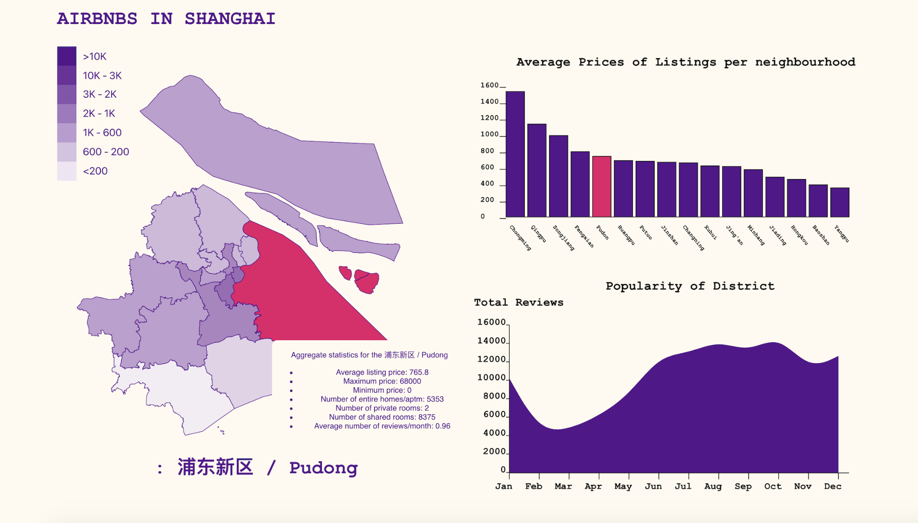
Interactions
Bidirectional linking between Choropleth map and Bar chart
Unidirectional linking between both Choropleth map, Bar chart and Time series chart

Slide 8
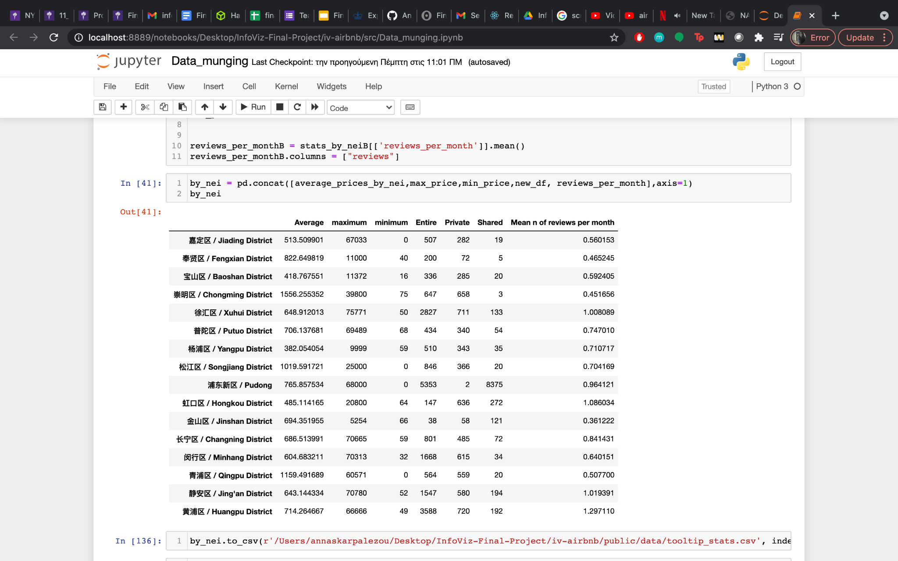
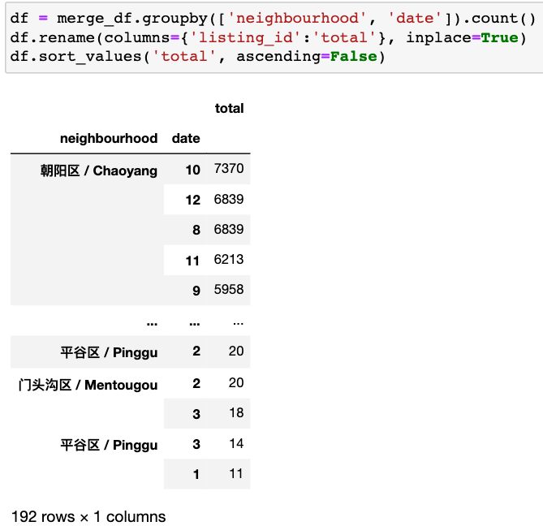
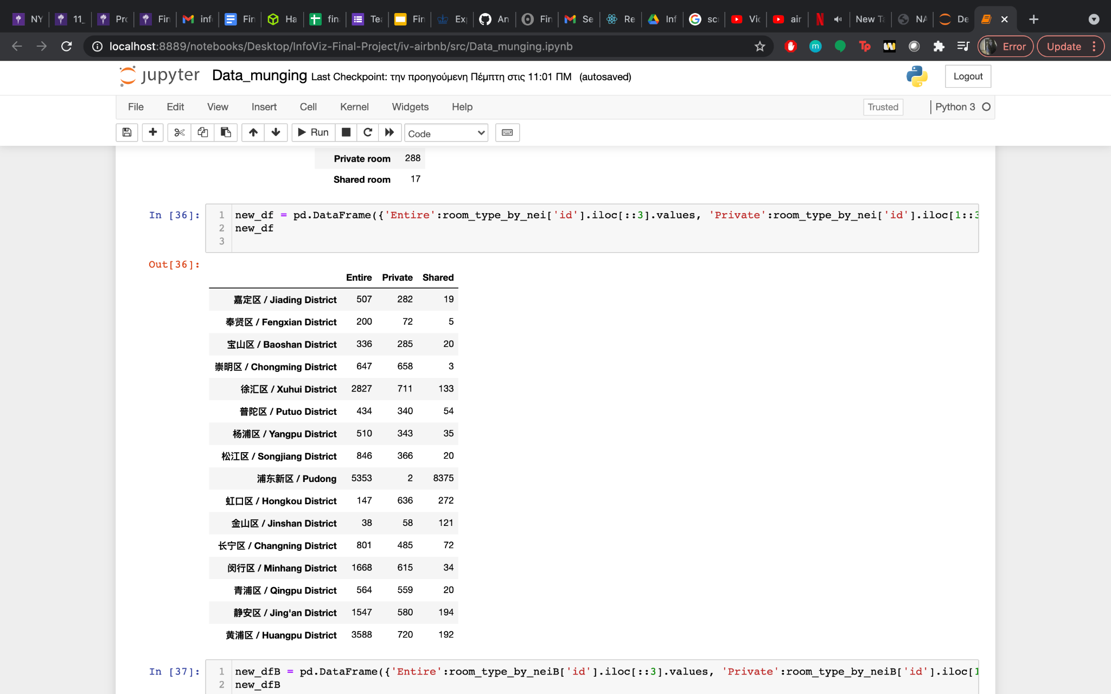
Novelty: Data Processing
Very large datasets
=>
Used pandas on jupyter notebook
And exported the dataframes as csv files

Slide 9


Tech Stack
Frontend:
ReactJS
HTML
CSS
D3.js
Backend:
NodeJS
Data:
Python Pandas

Slide 10
Thank you!
We would love to answer any questions you might have.

